Slide 1
The Illusion of Competence
Why AI-Generated Procedures Pass the Visual Test but Fail the Human Performance Test in LNG Operations.
Presented by: Stephen McCord | Procedure Solutions Management

Slide 2
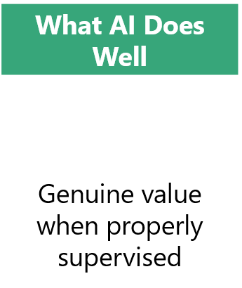
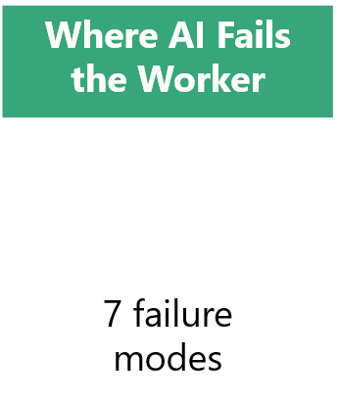
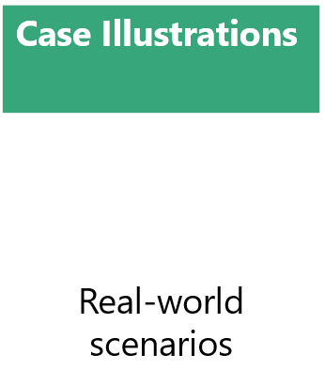
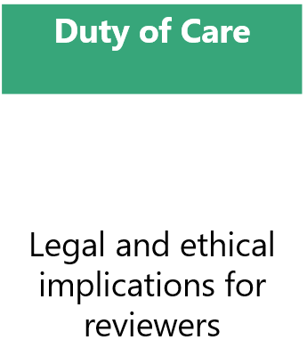
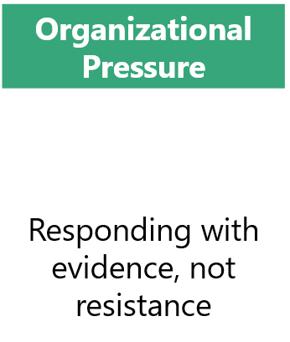
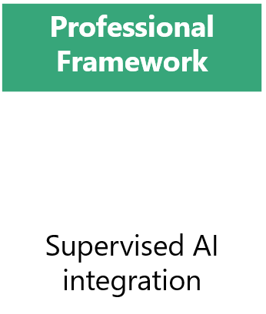
What we’ll cover:

Slide 3
The Visual Test - PASSES
Well-structured headings and numbered steps
Active tone and consistent language
Meets surface-level PPA formatting criteria
Polished and complete at first glance
Satisfies reviewers who skim for format
Two Different Tests
Human Performance Test - FAILS
Cannot infer who performs what and when
Smooths over uncertainty with plausible text
Misses hidden dependencies between steps
Omits conditional logic and exception paths
Produces operationally fragile procedures
In high-risk industries, even a small omission is not a documentation error – it is a hazard with professional-looking formatting.
Notes:
AI-generated procedures often pass visual tests because they are well structured, look polished and complete, but they fail the human performance test because real procedure writing depends on knowledge, context, and exception handling that AI routinely misses. In high-risk settings, the gap is even larger. A procedure can look correct while still being unsafe, incomplete, or unusable in the field.
AI is great at producing familiar documentation patterns – meeting surface level PPA criteria. Headings, numbered steps, active tone, and consistent language. It makes the procedure credible at a glance, especially when reviewers skim for format and content rather than execution. The language model satisfies a visual criterion without demonstrating that the procedure works in a live setting.
Real procedure performance depends on details AI often cannot infer: who actually performs what, which steps are conditional and what those conditions mean in practice, and what tools or systems are truly present on the ground. AI also tends to smooth over uncertainty, it fills gaps with plausible-sounding content, invents resolutions to questions that should remain open, and misses hidden dependencies that only experienced personnel would recognize. AI can generate the words, but doesn't know the why. This leaves the performer with procedures that appear competent, but are operationally fragile, and more importantly, risky. In high risk industries, nuclear, electrical, oil and gas, hospitals, even a small omission or wrong assumption is not only a documentation error, its a hazard with professional formatting.
A reviewer’s visual test measures form, but the human performance test measures behavior. The procedure can be well written, but still fail because it doesn’t reflect the real decision logic, safety constraints, or expertise that qualified workers rely on to execute safely.

Slide 4
What AI Does Well
Genuine value – when properly supervised
Brainstorming
Formatting Consistency
Regulatory Mapping
Template Development
Clarity Improvements
Version Control
Drafting Speed
Notes:
AI performs best at the front-end and cleanup stages of procedure writing, where structure, speed, and consistency matter more than operational expertise. AI can support the procedure writer in many instances.
All of this is dependent upon the users prompting and the information shared with the AI model.
Brainstorming – AI can be useful for brainstorming what procedures should exist, steps a process might need, and what variations or exceptions should be considered. It can also generate alternate outlines or prompt users with overlooked questions, helping to uncover gaps early. This is one of the safest uses because it supports idea expansion without claiming final authority over procedures.
Template development – AI can help build reusable templates by proposing sections like purpose, scope, responsibility, procedure steps, references, and revision control. This is especially useful when teams are developing multiple procedures and must retain consistent document architecture across them. In practice, AI is better at suggesting a starting template than inventing a final standard on its own.
Drafting speed – AI can turn a transcript, notes, or rough process description into a structured first draft very quickly, cutting the blank-page burden. The biggest time savings come from converting messy source material into a usable outline, not from producing a final procedure that is ready for review.
Formatting consistency – AI is great at enforcing a standard document shape: headings, numbered steps, terminology, tone, and repetitive language patterns. This helps writers keep procedures visually consistent throughout the document (and workplace). This benefit is even better when writers already have a template or style guide and want AI to normalize drafts to that format.
Clarity improvements – AI can rewrite dense or technical instructions into simpler language, shorten wordy sections, and reduce ambiguity. It is especially helpful at turning passive, abstract, or overly formal text into direct, active voice procedures that are easier for staff to follow and result in less human errors. This improvement is best applied to content that already reflects the correct process and only needs better expression.
Regulatory language mapping – AI can help map external regulations and standards into internal procedures by spotting correspondences and gaps. This is incredibly useful in compliance programs where the volume of content is large, and the goal is to create a traceability matrix or gap analysis. The value of AI is demonstrated by accelerating discovery and alignment, not by replacing legal or compliance review.
Version control support – AI can support identifying changed sections, summarize revisions, generate change logs, and draft update notes when procedures evolve. In practice, this works best when version control is established; AI can be used to reduce manual review effort, not decide what the authority on version control is. Strong version control processes support safer AI-generated edits because mistakes can be traced and revised.
Procedure writing can be slowed down by blank-page friction, inconsistent wording, and the need to translate messy operational knowledge into something readable. AI reduces that friction by giving you a draft quickly, allowing the human writer to focus on accuracy, exceptions, controls, and approvals. Additionally, AI works best with the parts of writing that are repetitive, structural, and predictive, not the parts that require authority, validation, or operational judgement and experience. The win in using AI is that it can compress the mechanical parts of the timeline, ensuring writers can spend their time focused on the procedure itself.

Slide 5
7 Failure Modes
Cognitive Load Calibration
Decision Point Clarity
Where AI Fails
the Worker
Error-likely Situation Recognition
Task Boundary Recognition
Conditional Logic Structure
The 7 failure modes that AI cannot resolve.
Warnings and Cautions Placement
Recover Step Design
Notes:
AI cannot replace human judgement
While AI can support a writer in many ways, there continue to be significant human factor elements in which AI can cause catastrophic failure because they require human judgement, operation context and experience, and error trap knowledge rather than fluent appearing text generation. In procedure writing, AI may produce a document that looks and sounds acceptable, but still leaves the end-user exposed to overload, ambiguity, or unsafe execution.
Cognitive load calibration – AI cannot reliably judge how much information a worker can absorb at once, so it may create steps that are too dense, too vague, or too fragmented, essentially overlooking all the criteria of the procedure writing process. Human factored guidance ensures that automation can reduce workload, but doesn’t create an overreliance and loss of situational awareness if the procedure is not designed around the end user’s mental load. PPA Procedure guidelines dictate breaking information into one, maybe two actionable steps, whereas AI will attempt to optimize completeness or fluency instead of the cognitive needs and the end user.
Decision point clarity – AI can state what to do, but not exactly when the end user must decide, escalate, verify, or stop, i.e. conditional steps. This matters because procedures fail when decision boundaries are unclear, leading to an error trap that can be either damaging or devastating. AI will attempt to infer whether a step is action based or conditional, but human factored procedures stress the clarity needed to write safe procedures.
Error-likely situation recognition – AI is weak at identifying where a human is likely to make a mistake in the real word environment. Human factored procedures specifically call out potential error traps, ensuring risks are mitigated, especially during times of stress, ambiguity, or competing demands.
Task boundary definition – AI struggles to define where one role ends and another begins, especially if the work crosses teams, shifts, or systems. Human factored procedures ensure the clarity needed to successfully identify workflows and user responsibilities. Without the boundary clearly defined, workers may duplicate efforts, skip steps, or assume someone else is responsible for next moves.
Conditional logic structure – AI is capable of drafting “IF…THEN” language, but it often misses nested conditions, exception branches, and escalation paths. This is a major problem when high-risk environments depend on conditional steps when executing potentially dangerous procedures. Human factored design requires explicit logic when developing action steps, ensuring clarity in the execution. AI is not capable of reliably producing these steps without strong source material and expert editing.
Warnings and cautions placement – AI may include warnings and cautions but does not have the capability to reliably place them where they are needed to prevent damage or harm. Human factored procedures identify the importance of timing and positioning to support safe action that is not just identified generically in the document. In other words, a warning buried at the start of a lengthy procedure may be ignored, whereas a warning placed in relation to a potentially risky step can change human behavior.
Recovery step design – AI is weak in designing procedures that support the worker when something goes wrong. AI is unable to predict breakdowns and cannot identify recovery methods to safely continue procedure execution. Human factored procedures include recover design that identifies ways the worker can back out safely, restore state, escalate and document issues, and continue without operating in a knowledge-based mode.
These seven elements are not just writing style issues, they are execution issues that can lead to missteps or disaster. A procedure can look polished but can still fail because it does not anticipate human need, limitation, or error states in the real environment.

Slide 6
Case Illustrations
Real-world examples of AI-generated procedure failures and the human factored principles that could have prevented them.
Clarity Improvements
Template Development
Drafting Speed
Notes:
Drafting Speed – Took 14 minutes; PSM Style Guide and an example of one of our templates.

Slide 7
AI-Tool A
AI-Tool B
NOTE Steps in this section may be performed in any order.
CAUTION Inserting an energized breaker into a cubicle while a Tagout is in effect can result in an uncontrolled energization of the load side.
a. PERFORM electrical maintenance on breakers or other work activities that cannot energize the load side under the following conditions:
1. IF a Danger Tag is installed on the breaker operating mechanism,
THEN MOVE the Danger Tag to the breaker cubicle door by a qualified individual authorized to hang tags.
2. ENSURE a tagged breaker is in the OPEN position and Temporary Lifted before inserting back into the cubicle.
3. IF motor electrical testing (Megger) is to be performed on a tagged component,
THEN CONFIRM the group or individuals performing the testing are the only Tagout Holders AND all other Holders are locked out before proceeding.
IF electrical maintenance on breakers or other work activities cannot energize the load side, THEN the following conditions shall be met:
a. A qualified individual shall REHANG the Danger Tag from the breaker operating mechanism to the breaker cubicle door.
b. A tagged breaker shall not be INSERTED into the cubicle unless the breaker is in the OPEN position and is TEMPORARILY LIFTED.
c. Motor electrical testing (megger testing) may be performed on a tagged component only when the performing group or individuals are the only Holders on the Tagout and all other Holders are LOCKED OUT.
Examples of AI vs AI writing styles
Case Illustrations
Notes:
AI A vs AI B
- Difference in perspective; AI does not know the difference

Slide 8
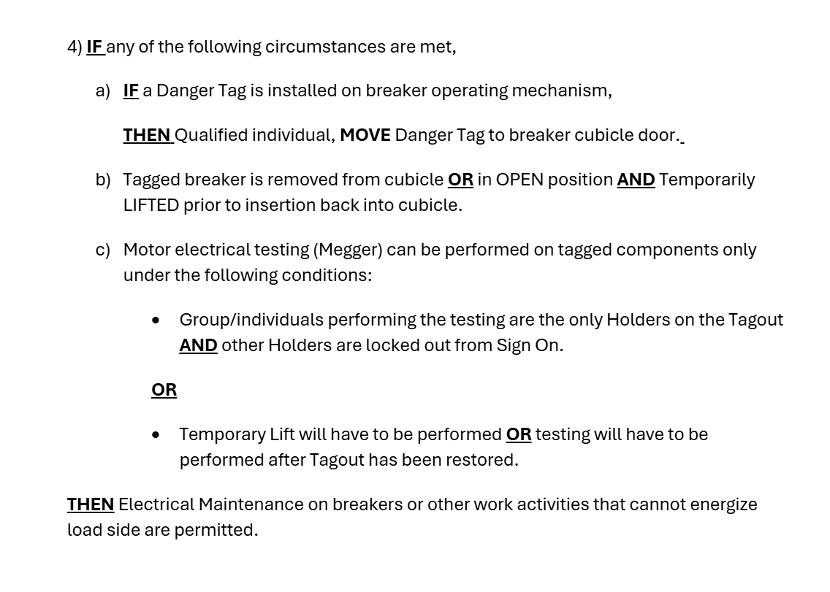
Human Factored Initial Draft
Case Illustrations
Notes:
AI A vs AI B
- Difference in perspective; AI does not know the difference

Slide 9
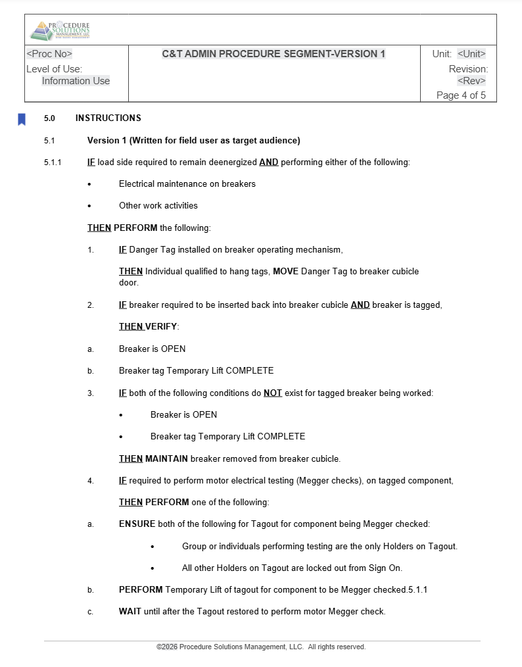
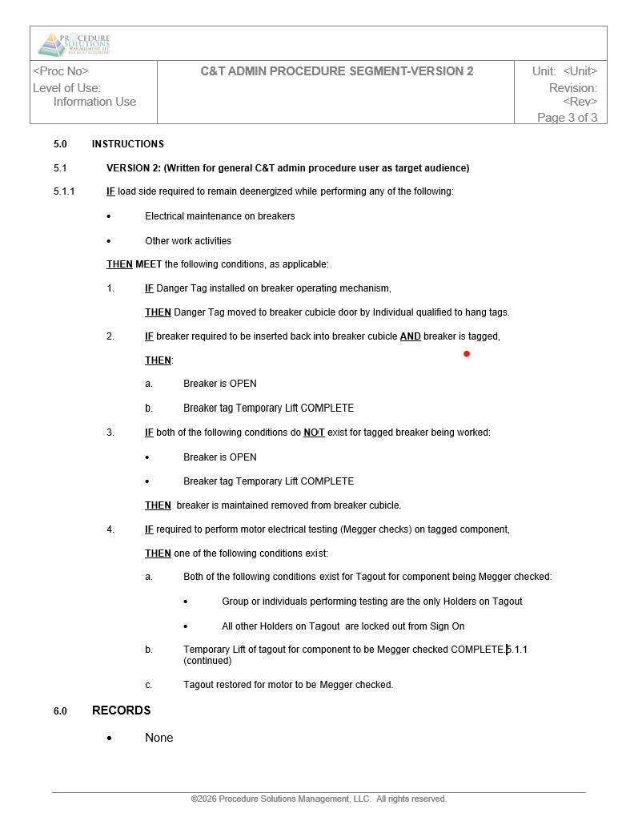
Human Factored Final Draft
Case Illustrations
Notes:
AI A vs AI B
- Difference in perspective; AI does not know the difference

Slide 10
What Duty of Care Requires
Generating ≠
Validating
Non-delegable Judgement
Duty of Care
Signature Attestation
Regulatory Compliance
The professional who reviews and signs off on a procedure bears responsibility for its fitness for use, not the tool that drafted it.
Notes:
This is where duty of care comes in, or OSHA’s General Duty Clause; and it enters whether your organization has named it or not.
Understand that generating does not equal validating.
We cannot delegate judgement to the AI Tool being used
Our signature attests that we as professionals (reviewers/validators) are verifying and taking ownership of this work
The regulators of industry establish that professionals cannot allow their professional judgement and skill to be automated.
Duty of care, in the professional and legal sense, is the obligation to exercise the level of judgement and diligence that a competent professional in your role would exercise given the foreseeable consequence of getting it wrong. In high-risk industries, that standard has always been high. Using AI doesn’t lower this standard, but it changes the ease with which output is produced. With that comes the temptation to treat production speed as a proxy for review quality.
Historically, procedures are a controlled document that are generated from other controlled documents. Professionals must recognize that AI can point you in the right direction by providing references or citations, but the legitimacy of those must be proven to be accurate and appropriate.
The legal framework is unambiguous on this point – generating a document is not the same as validating one. The professional who signs off on a producer bears responsibility for its fitness for use, not the tool that drafted it. A structural engineer can’t cite the CAD software when a building fails. A procedure professional cant cite the AI Language Model when a worker is injured following a step that was plausible on paper but wrong in the field. The signature on that document is not a formatting approval; it is a professional attestation that the content has been validated and approved against operational reality.
Several engineering ethics codes (NSPE – National Society of Professional Engineers and AIChE – American Institute of Chemical Engineers) establish explicitly that these professionals may not replace their professional judgement and skill to automated systems. The delegation itself is the breach. This isn’t a theoretical future concern; it is happening in high risk industries in current time.
As AI-assisted documentation becomes more common in regulated industries, the question of validation will be asked by regulators, legal counsel, and unfortunately, incident investigators.

Slide 11
Statistics
1,400 professionals in over 20 global industries were surveyed
72%
54%
48%
Responding to Organizational Pressure
Extreme Confidence
No Approval
Struggle Writing Prompts
The argument isn’t against AI, it’s about adopting in a responsible way.
50%
42%
Cite Misinformation
Lack Training
Notes:
This is where duty of care comes in, or OSHA’s General Duty Clause; and it enters whether your organization has named it or not.
Understand that generating does not equal validating.
We cannot delegate judgement to the AI Tool being used
Our signature attests that we as professionals (reviewers/validators) are verifying and taking ownership of this work
The regulators of industry establish that professionals cannot allow their professional judgement and skill to be automated.
Duty of care, in the professional and legal sense, is the obligation to exercise the level of judgement and diligence that a competent professional in your role would exercise given the foreseeable consequence of getting it wrong. In high-risk industries, that standard has always been high. Using AI doesn’t lower this standard, but it changes the ease with which output is produced. With that comes the temptation to treat production speed as a proxy for review quality.
Historically, procedures are a controlled document that are generated from other controlled documents. Professionals must recognize that AI can point you in the right direction by providing references or citations, but the legitimacy of those must be proven to be accurate and appropriate.
The legal framework is unambiguous on this point – generating a document is not the same as validating one. The professional who signs off on a producer bears responsibility for its fitness for use, not the tool that drafted it. A structural engineer can’t cite the CAD software when a building fails. A procedure professional cant cite the AI Language Model when a worker is injured following a step that was plausible on paper but wrong in the field. The signature on that document is not a formatting approval; it is a professional attestation that the content has been validated and approved against operational reality.
Several engineering ethics codes (NSPE – National Society of Professional Engineers and AIChE – American Institute of Chemical Engineers) establish explicitly that these professionals may not replace their professional judgement and skill to automated systems. The delegation itself is the breach. This isn’t a theoretical future concern; it is happening in high risk industries in current time.
As AI-assisted documentation becomes more common in regulated industries, the question of validation will be asked by regulators, legal counsel, and unfortunately, incident investigators.

Slide 12
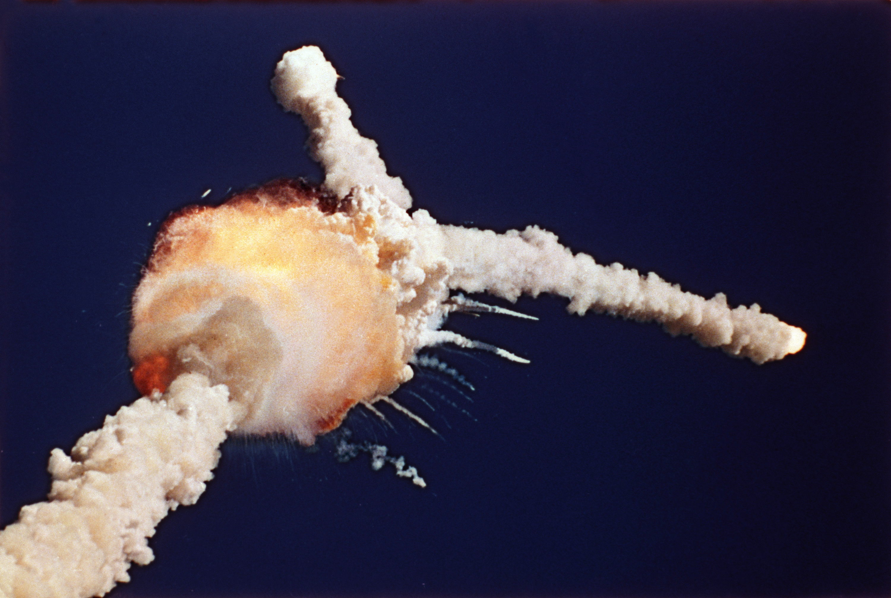
Normalization of Deviance
Diane Vaughan
The sociological mechanism where unsafe practice becomes normal if it does not immediately cause a problem.
Responding to Organizational Pressure
Notes:
The Challenger and Columbia disasters were caused by a mechanism called the normalization of deviance. Diane Vaughan coined the term after research and identification led her to discover the sociological causes of these disasters. The normalization of deviance is a process where an unsafe practice comes to be considered normal if it does not immediately cause a catastrophe. Over time, the unsafe practice becomes the accepted practice because the absence of incident is mistaken for safety.
With AI, the deviance looks like this: skipping independent verification of an AI output, then do it again because last time was fine, until “the AI said so” replaces “I confirmed it”. The reinforcement is faster, seductive even, than with most engineering deviations because the tools are fluent, confident and “right enough” to train complacency.
Many industries are on the cusp of AI adoption and implementation, the new normal. While there haven’t been specific cases in high risk industries, there have been cases in law (Mata v. Avianca where lawyers cited non- existent cases in their filings) and in the medical field where confident but inaccurate outputs passed review because the reviewer had stopped reviewing.
The reason this matters is that AI can defeat the usual error sources. Our defenses as procedure writers – independent verification, peer check, questioning attitude, stop-when-unsure, all assume the error source looks uncertain or produces obviously wrong output. A Large Language Model produces fluent, plausible, confidently worded output that is occasionally and unpredictably wrong, precisely eroding a questioning attitude. It’s the articulate colleague who is wrong some of the time without ever sounding wrong.
Our role is not to resist AI adoption, but to support the responsible adoption by clearly distinguishing between where AI can assist and what it can’t replace. Our goal is to ensure that we continue to maintain the same standards to ensure AI doesn’t become the next Normalization of Deviance catastrophe.

Slide 13
The Pressure is Real
The Pressure
Leadership sees increased efficiency and lower costs
AI output looks polished and complete
AI use becomes a dependency to decrease workload
The Wrong Response
The Right Response
Treating AI as a final draft
Compressing or skipping human factored validation
Signing off because it looks right
Define responsible adoption
Distinguish what AI can do and can’t do
Ask: What does approval mean?
Responding to Organizational Pressure
Notes:
Efficiency gains from AI assistance are genuine and visible. Leadership sees the reduced drafting time and lower labor costs. What they don’t see is the risk that builds under the surface when human factoring is compressed or skipped to match the pace of AI output.
AI can generate a draft it minutes, but it can’t walk through a procedure in the field. It cannot recognize an error trap. It cannot determine if a step will be skipped under pressure, misread in low light, or misapplied when the system conditions differ from the norm. Those all require a human expert and time that is not negotiable.
We as professionals need to be able to ask, “what does our organizations acceptance of AI mean for risk, responsibility, and professional obligation?” to ensure AI adoption is safe, reliable, and repeatable.

Slide 14
The Human Factored AI Integration Model
Human-led Scoping
Human-controlled phase
Human-factored Review
AI-assisted phase
Non-delegatable checkpoint
Operational Validation
AI-assisted Drafting
Human-factored Signoff
Professional Signoff
Procedure Released for Use
Compliance and Approval
Technical Accuracy Review
Field Review
Professional Framework
Notes:
Human led scoping
Writer and/or SME defines task, context, hazards/warnings, roles and responsibilities, exceptions
AI assisted drafting
AI generates structure, steps, and formatting
Technical accuracy review
SME validates all steps, values, system requirements, etc.
Human factored review
Validate cognitive load, decision point clarity, error traps, warning/cautions/notes, task boundaries, conditional logic, recovery
Human factored sign off
Implement writer checklist
Field review
Qualified performer validates against actual or simulated field conditions
Operational validation
Sign off – procedure performs under realistic conditions
Compliance and approval
Verify regulatory alignment
Professional signoff
Final approver attests to “duty of care” responsibility
Procedure released for use

Slide 15
Procedure Writer’s Responsibility
The procedure that leaves your desk is the one you can stand behind.
Competence
What does this mean for Procedure Writers?
Validation
AI is best treated as a drafting assistant, not a procedure authority. Writers can work WITH AI, but AI cannot author in a writer’s place. Accountability for procedures remains with the human.
Professional Obligation
Notes:
AI is best treated as a drafting assistant, not a process authority. It can accelerate structure development, improve clarity, and enforce consistency, and those are all contributions worth using. But this is a starting point, not a product. Humans experts must validate the procedure against actual practice, edge cases, exception conditions, and compliance requirements. AI can help drafting or simplifying, but field workers or SMEs must validate by walking through as if they were performing the procedure in real life.
Remember, AI outputs predictive language patterns based on what similar documents have looked like. It doesn’t hold the years of operational experience, contextual judgement, and knowledge held by qualified practitioners. That gap is our responsibility to ensure everyone goes home safe at the end of the day.

Slide 16


Let’s Connect
Continue the conversation with me at the Procedure Solutions Booth [B34] or scan the code and reach out.
Scan the code or visit:
PROCEDURESOLUTION.COM/LNG2026

